Slide 1


Hand gesture recognition in industry
By
Thiry Nicolas
Dumoulin William

Slide 2

01
Project
02
Dataset
03
Model
04
Accuracy
05
Demonstration
06
Limits

Slide 3
Project
01

Slide 4
Project
Goal of the project
Obligations
Gesture
Industry

Slide 5
Dataset
02

Slide 6
Dataset
12 persons, 4 times each gesture
1500 videos
61 frames

Slide 7
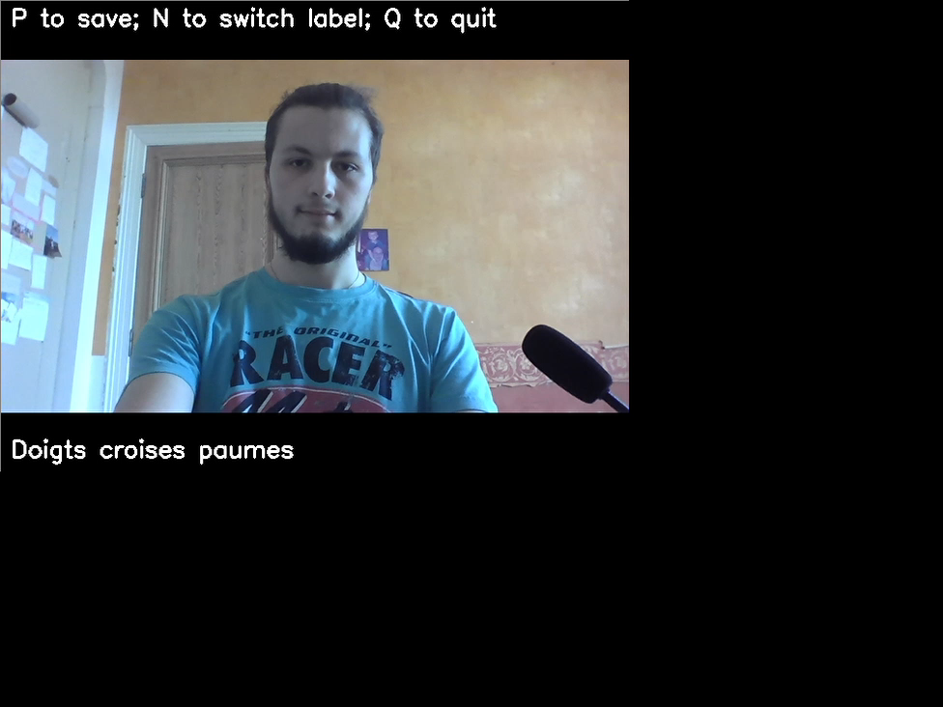

Slide 8
Model
03

Slide 9
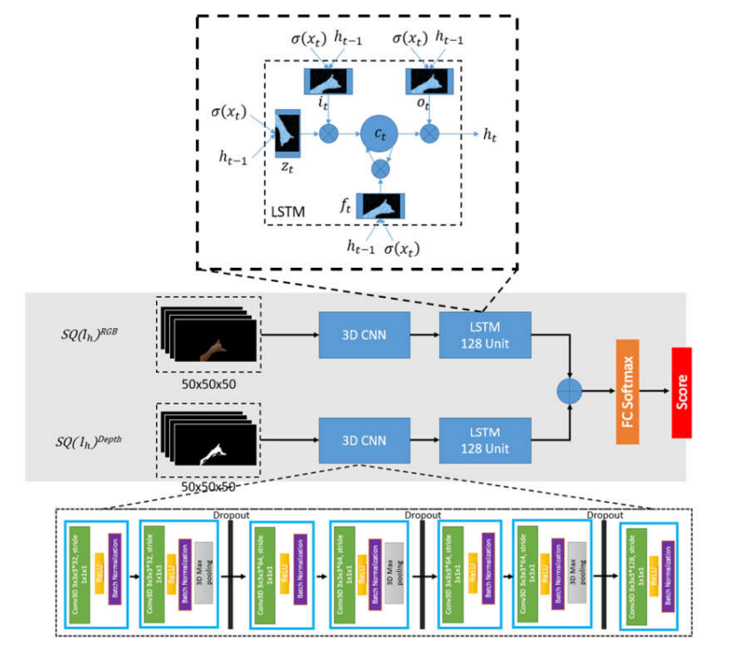
Model
Dynamic Hand Gesture Recognition Using 3DCNN and LSTM with FSM Context-Aware Model
Their accuracy = 92 %

Slide 10
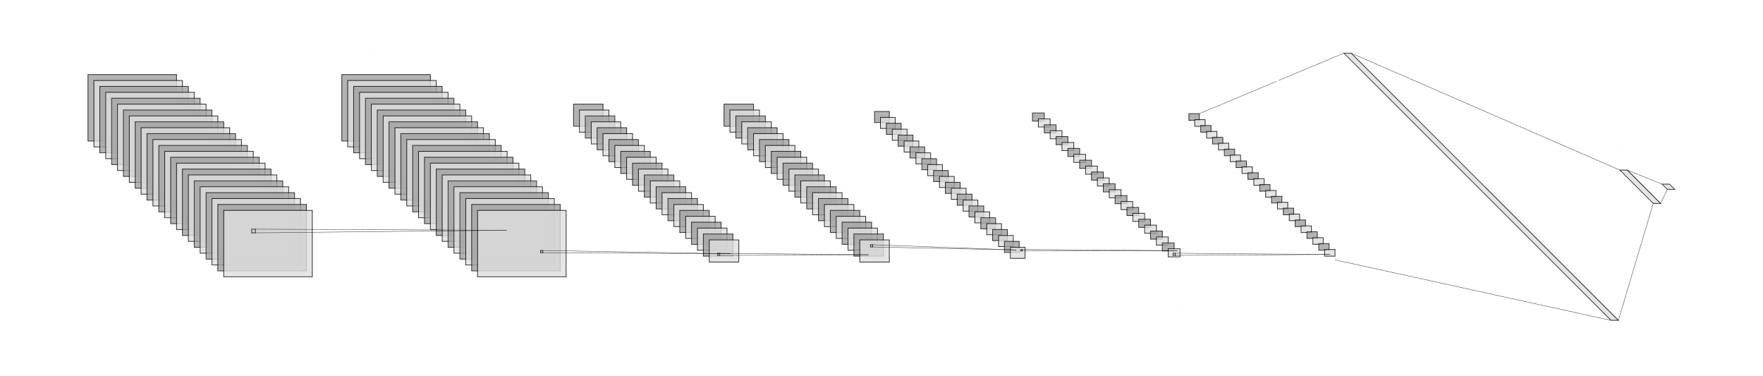
Our Architecture

Slide 11
Accuracy
04

Slide 12
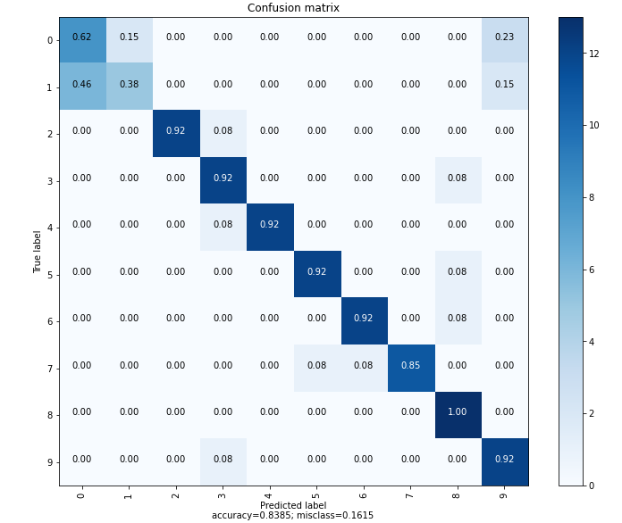
Accuracy
83,8%

Slide 13
Demonstration
05

Slide 14
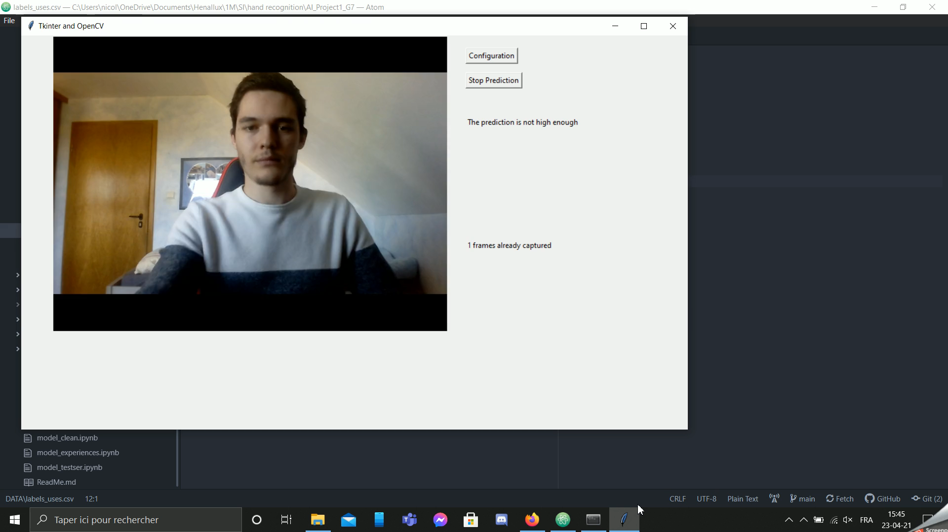

Slide 15
Limits
06

Slide 16
Limits
Viewing angle
Speed of the gesture
Camera-gesture distance

Slide 17

Thank You for your attention

